Slide 1
Online sketches with random features
Nicolas Keriven
Ecole Normale Supérieure (Paris)
CFM-ENS chair in Data Science, « Laplace » post-doc
(PhD with Rémi Gribonval at Inria Rennes)
Paris Science and Data, Apr. 5th 2018

Slide 2
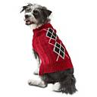
Online sketches
Database
Task
Learning
Clustering
Classification
etc…
= cat
Data Stream
?
…
…
Idea!
Maintain data sketch
Distributed database
Desired properties
Fast to compute
Preserve desired information
Preserve data privacy
1/9

Slide 3
A very simple example
Data Stream
What information ?
…
…
Capture the mean of the data
Memory use:
Update cost:
Sketch
Can we learn something more useful ?
2/9

Slide 4
Random features
Data Stream
What information ?
…
…
Capture generalized moments
Example: histograms…
Memory use:
Update cost:
Sketch
In this talk…
For the mathematicians…
With high probability, approx. the kernel mean (Gretton 2008): contains all info. about distrib. of
as random features (random projection + non-linearity)
With LightOn optical technology:
even for HD data
Energy efficient
3/9

Slide 5
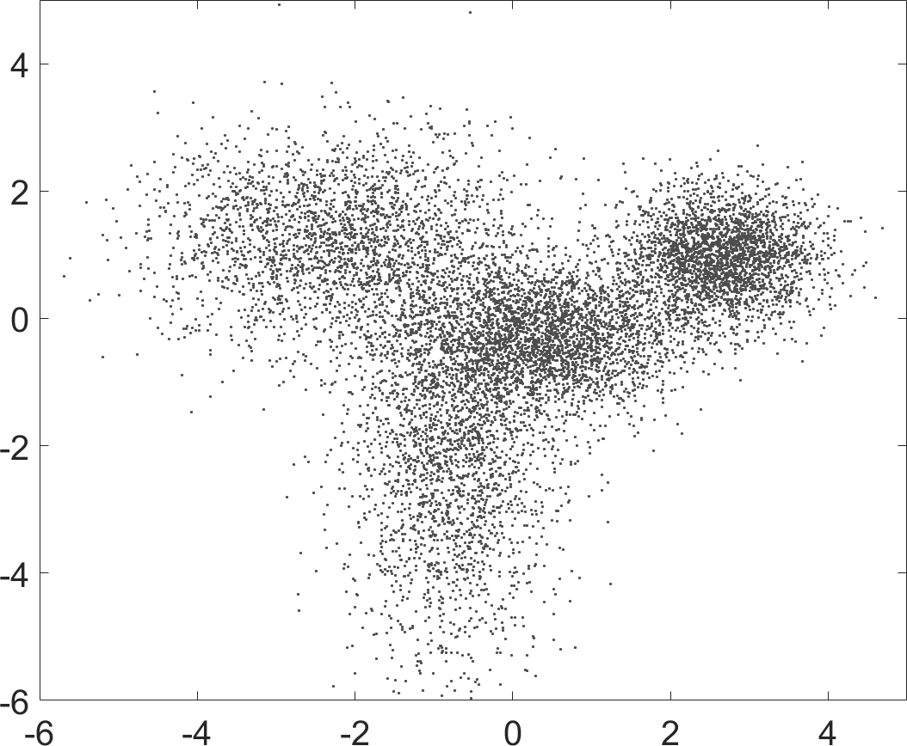
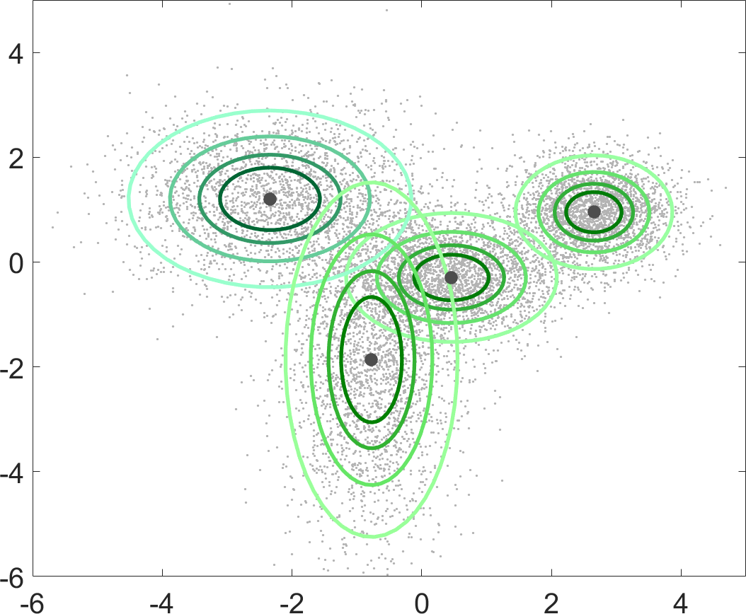
Application 1: Sketch clustering
Sketching
Moment matching
Theorem [Gribonval, Blanchard, K., Traonmilin 2017]
With sufficiently many random features, with high probability the moment matching method is successful for
K-means (mixtures of Diracs)
Mixture models learning (GMM,…)
Modelisation of the distribution of the data.
Proof: information-preservation techniques on the probability distribution of the data. Infinite-dimensional analysis !
Greedy heuristic for moment matching: Compressive Learning OMPR (CL-OMPR) [Keriven 2016]
4/9

Slide 6
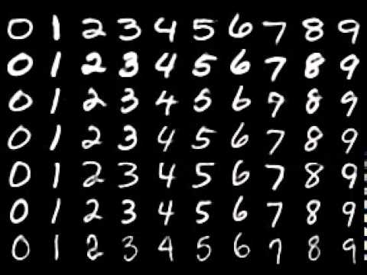
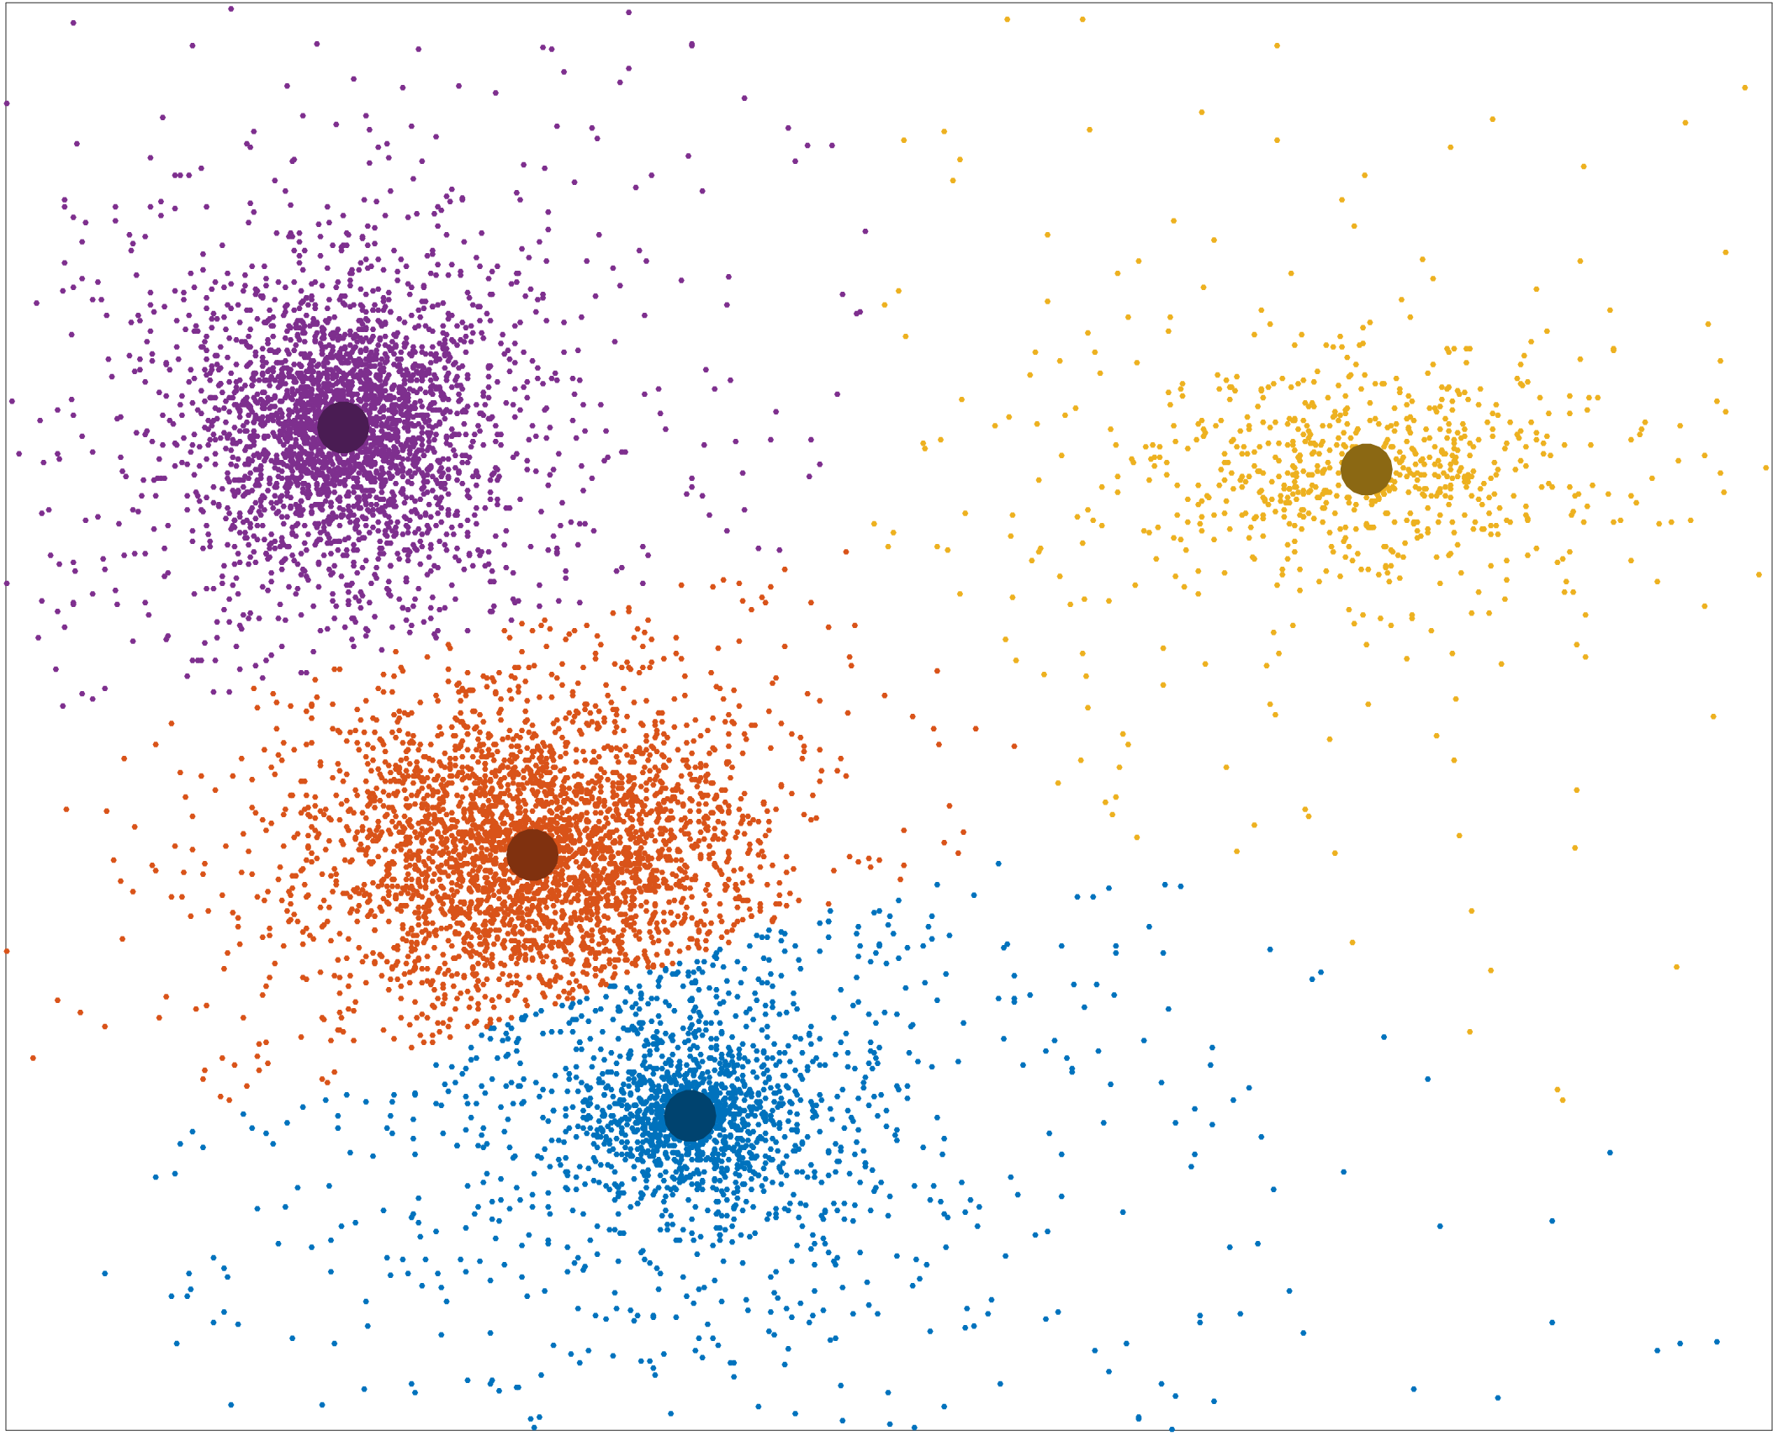
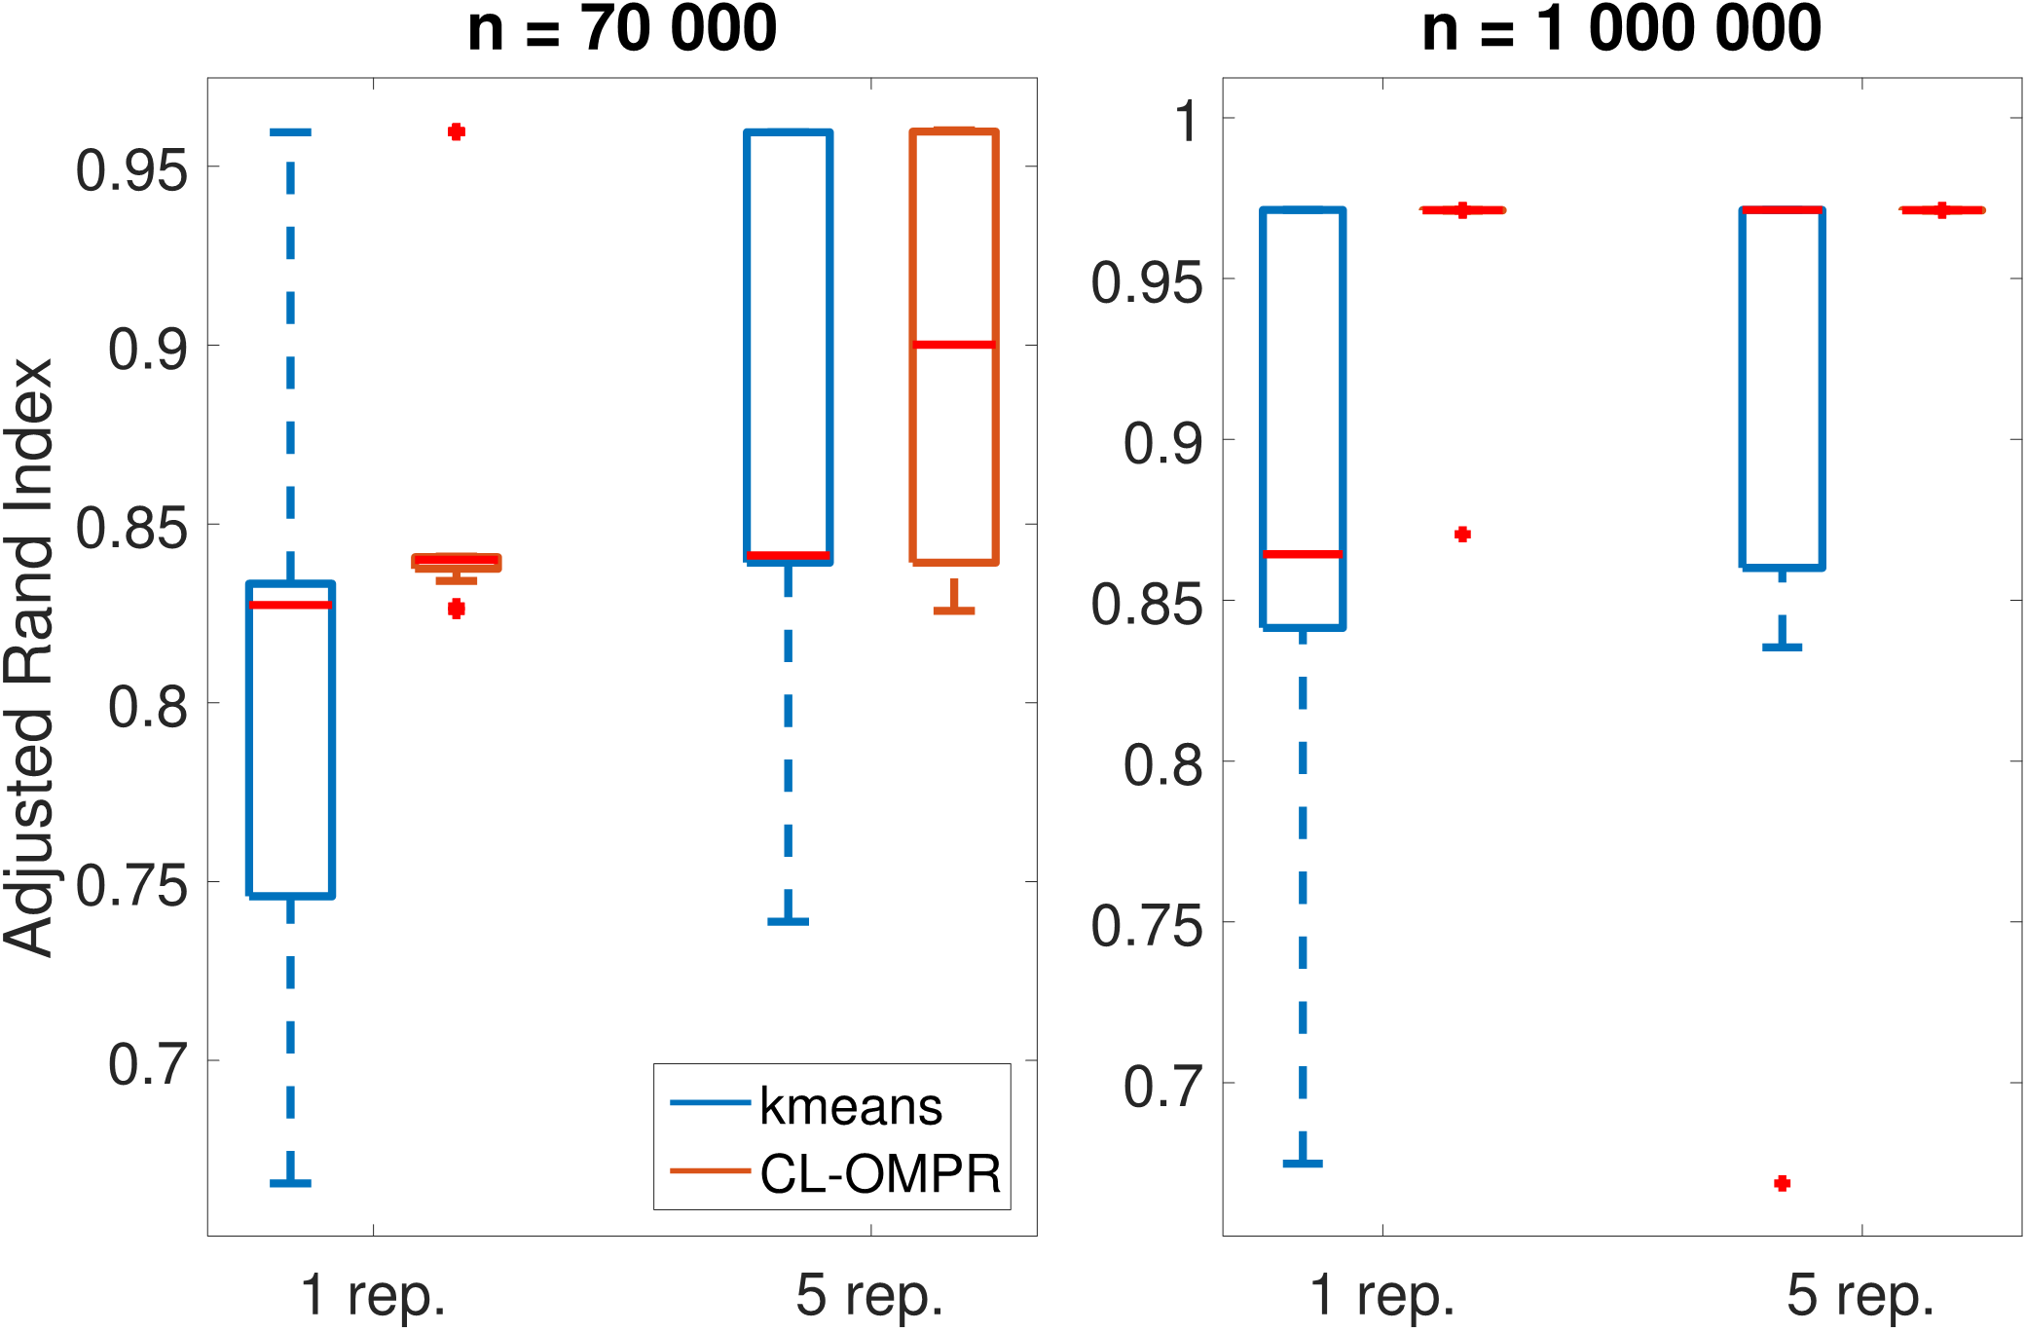
Result: Compressive k-means [Keriven et al 2017]
Mixture of Diracs = k-means
Application: Spectral clustering for MNIST classification [Uw 2001]
Classif. Perf.
On this example…
1 order of magnitude faster than k-means
4 orders of magnitude more memory efficient
5/9

Slide 7
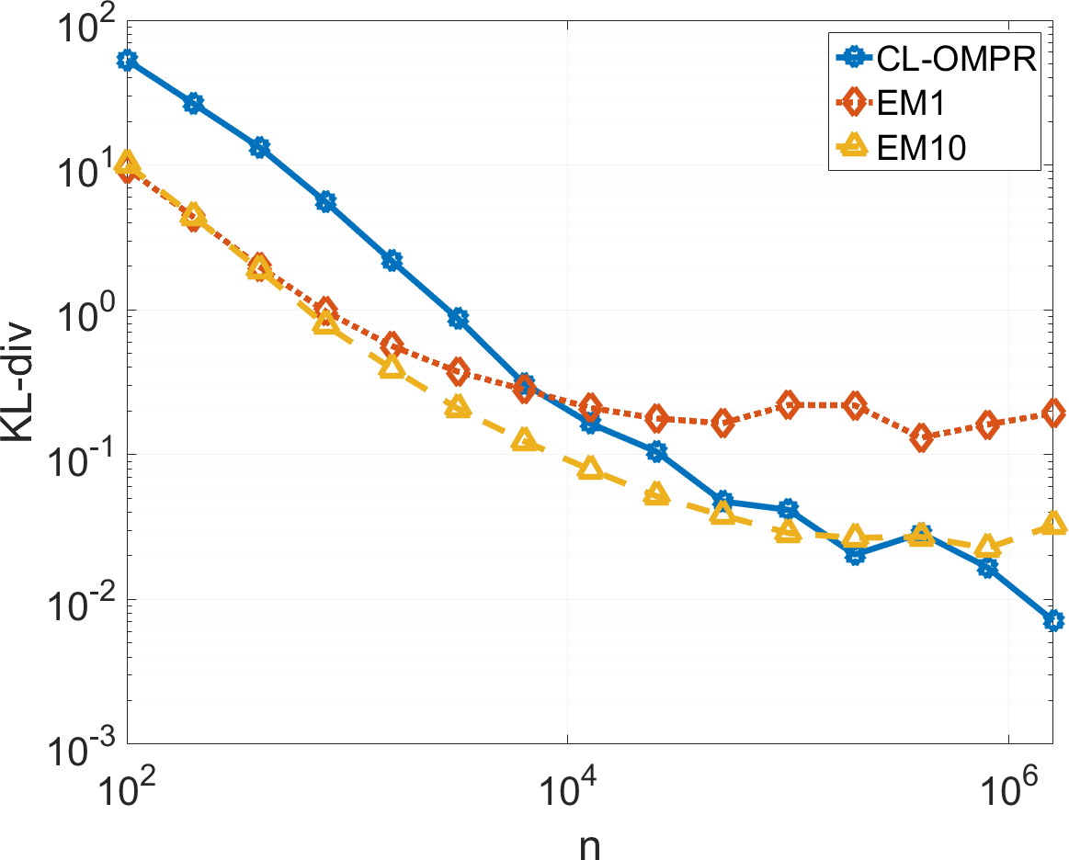
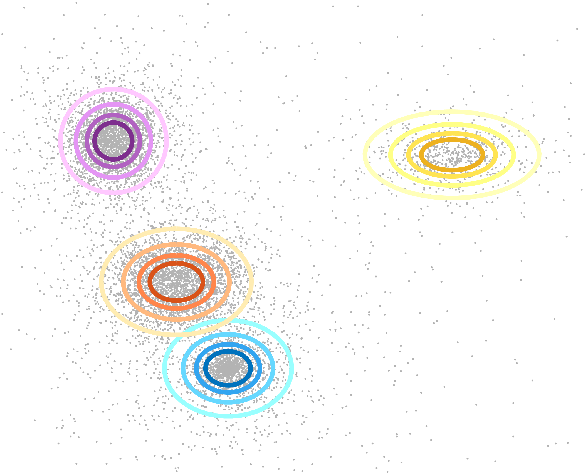
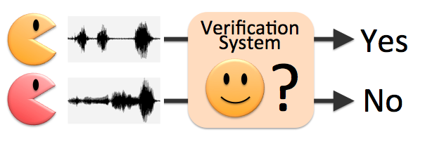
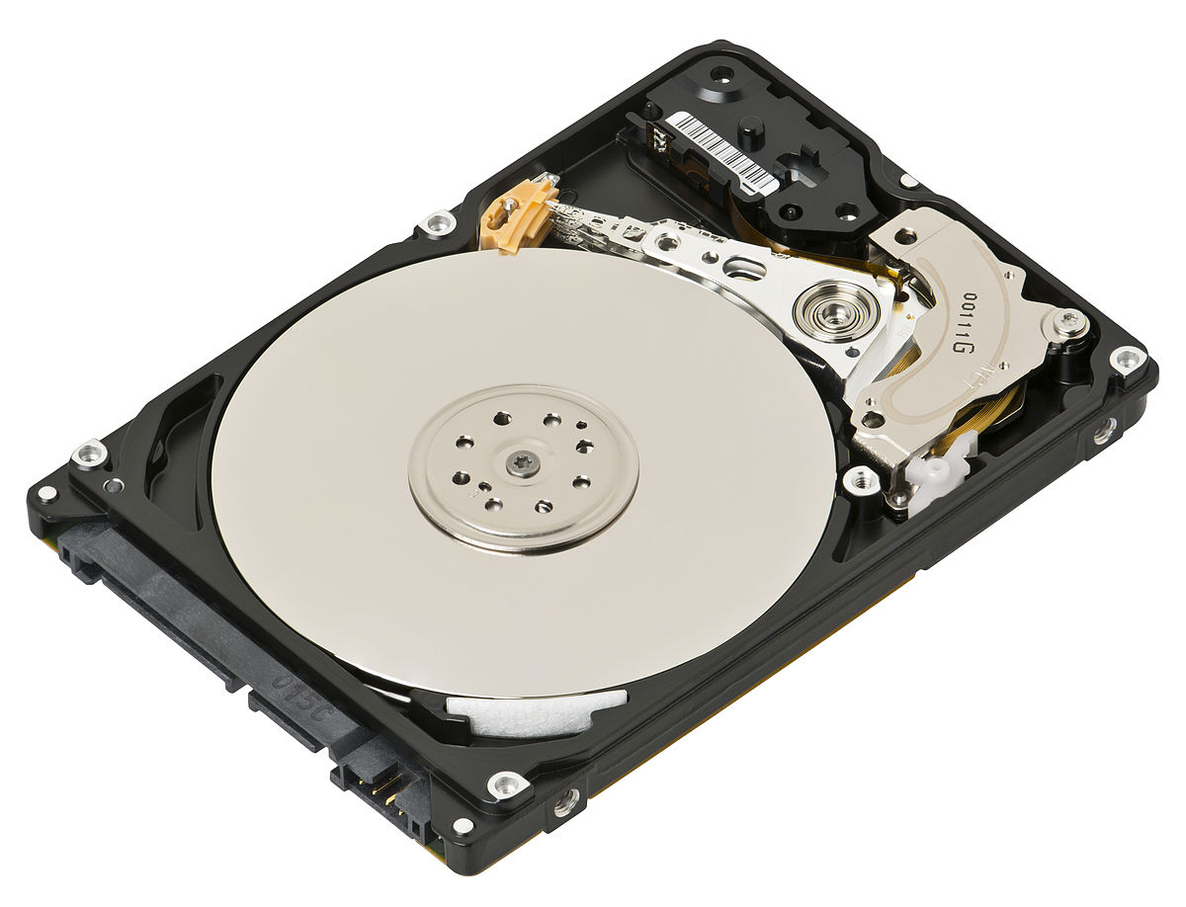
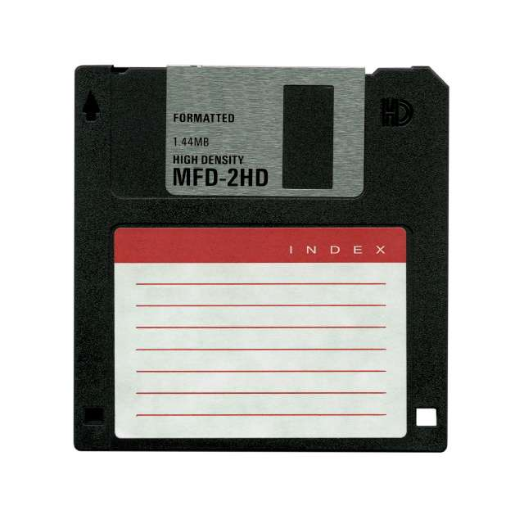
Gaussian mixture models
GMM
d = 10, k = 20
Error
Faster than EM
(VLFeat’s gmm)
Size of database
Application: speaker verification [Reynolds 2000] (d=12, k=64)
EM on 300 000 vectors : 29.53
20kB sketch computed on 50GB database: 28.96
6/9

Slide 8
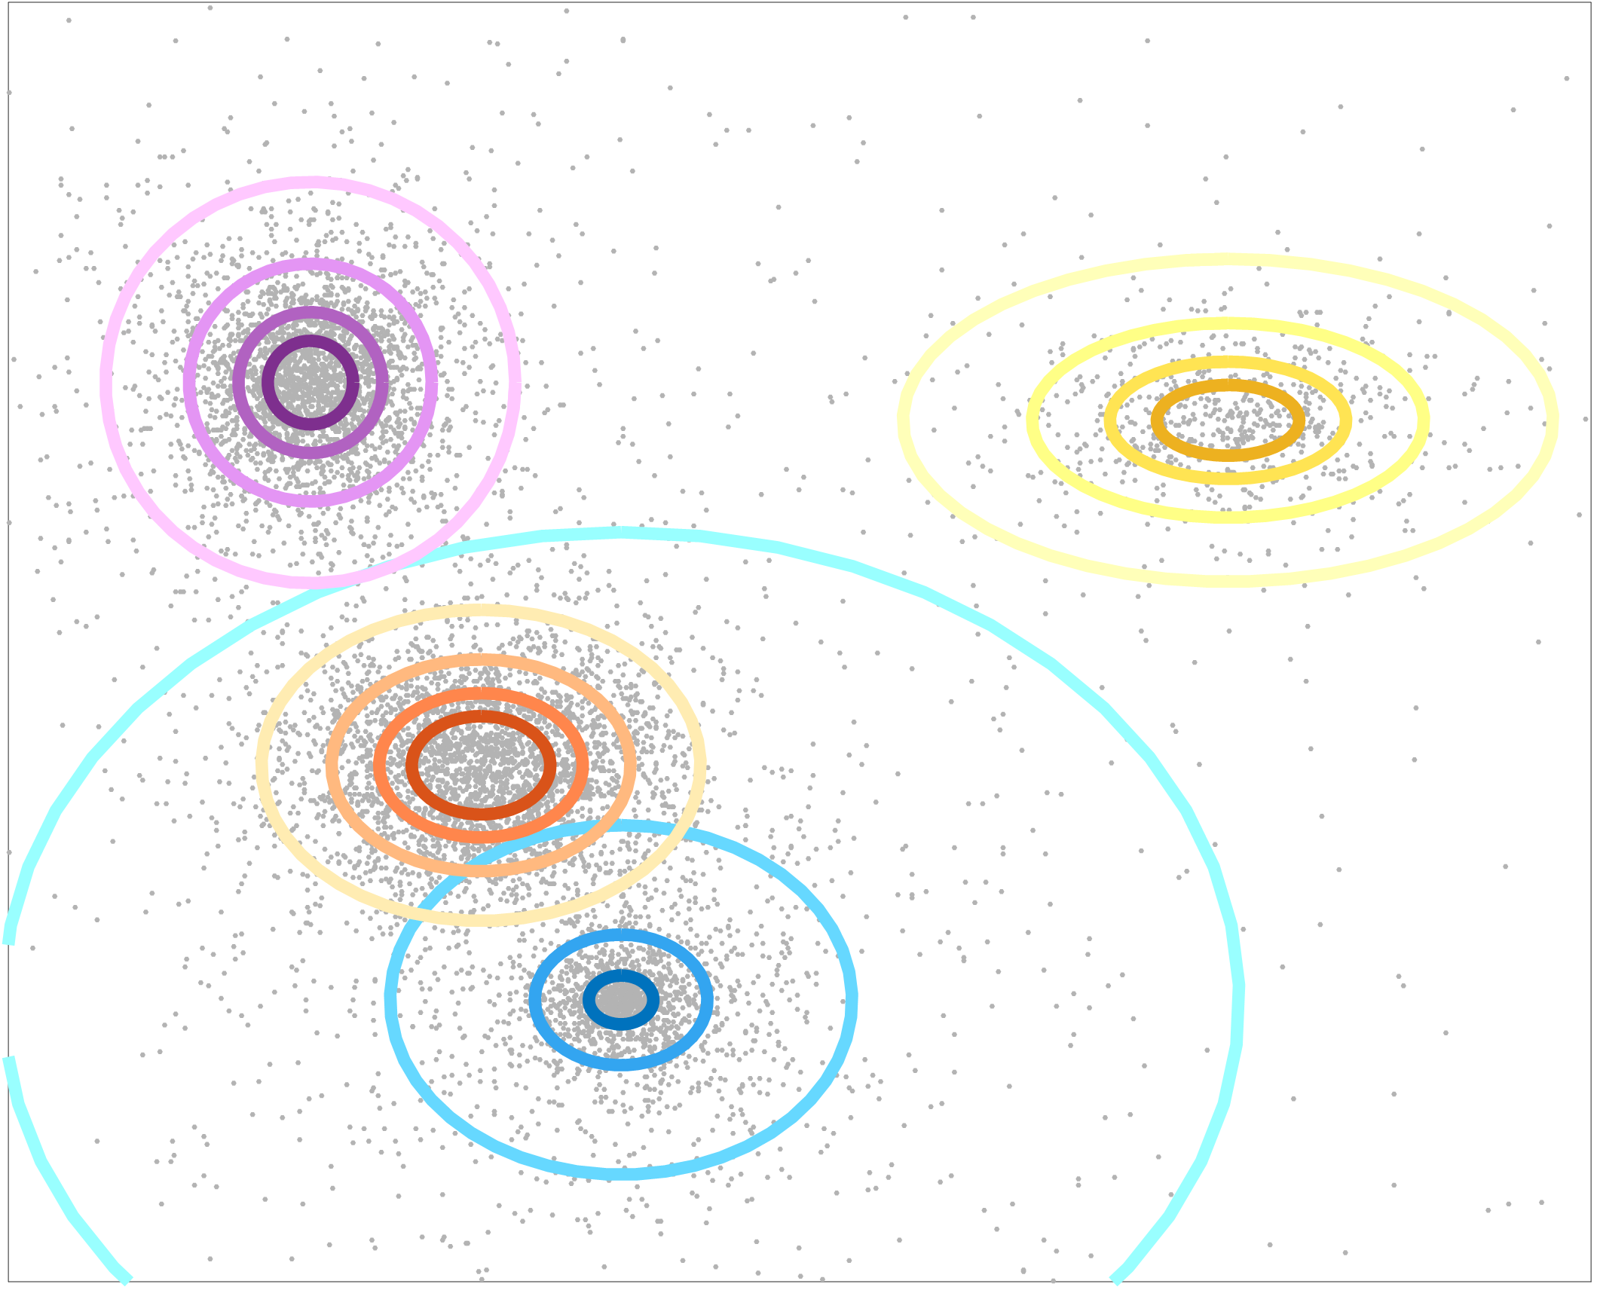
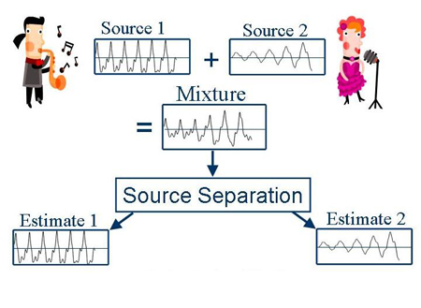
Audio Source separation [Keriven et al 2018]
Mixture of stable dist.
Application: audio source separation
Model: hybrid between rank-1 alpha-stable and Gaussian noise…
7/9

Slide 9
Application 2: Online change point detection
Online change point detection:
detect abrupt variations in a stream of data, by comparing two sketches.
Help detecting extreme events, or selecting which data to store (segmentation)
Applications in:
Video monitoring
Seismic data
Speech detection
…
8/9

Slide 10
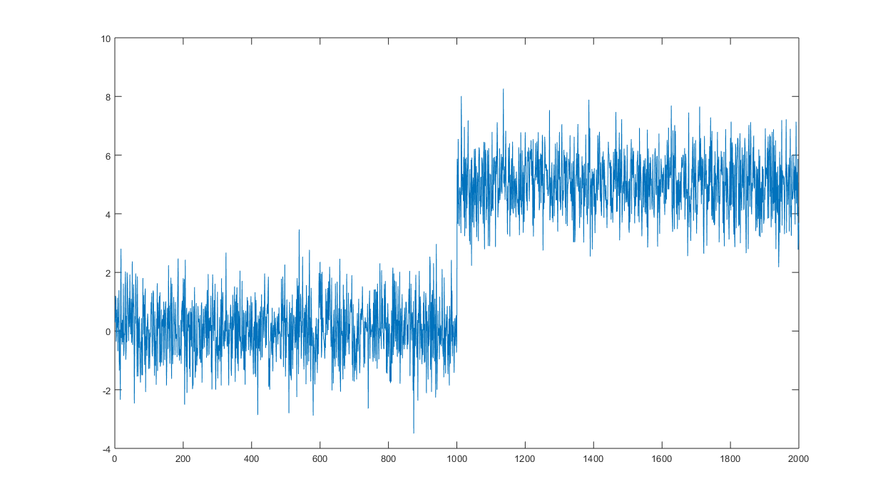
Application 2: Online change point detection
: detect variations in the mean of
: detect variations in the mean of
= any change in distribution
Theorem [Keriven2018]
With sufficiently many random features, with high probability, the online change point detection procedure detects any significant change in the distribution of samples.
Toy example: On a small laptop, no parallel computing, memory footprint < 5kb…
8/9

Slide 11
Conclusion
« D’ici 2040, les besoins en espace de stockage mondial […] risquent d’excéder la production disponible globale de silicium »
Rapport Villani
Data Stream
…
…
Online sketches:
Handle streams of data, preserves data privacy
Using random features:
Capture all information about underlying probability distribution of data
Can be computed extremely efficiently
9/9

Slide 12
Thank you !
Keriven, Bourrier, Gribonval, Pérez. Sketching for Large-Scale Learning of Mixture Models Information & Inference: a Journal of the IMA, 2017. <arXiv:1606.02838>
Keriven, Tremblay, Traonmilin, Gribonval. Compressive k-means ICASSP, 2017.
Gribonval, Blanchard, Keriven, Traonmilin. Compressive Statistical Learning with Random Feature Moments. Preprint 2017. <arXiv:1706.07180>
Keriven. Sketching for Large-Scale Learning of Mixture Models. PhD Thesis. <tel-01620815>
Code: sketchml.gforge.inria.fr
github: nkeriven
data-ens.github.io
Come to the colloquium!
Come to the Laplace seminars!

